Slide 1
Thermodynamics, is also the Study of Enthalpy and Entropy
Objective 1: Analysis of Work and Heat Interaction on Working Fluids
Objective 2: Efficiency and COP, Pay for Fuel or Electric Energy

Slide 2
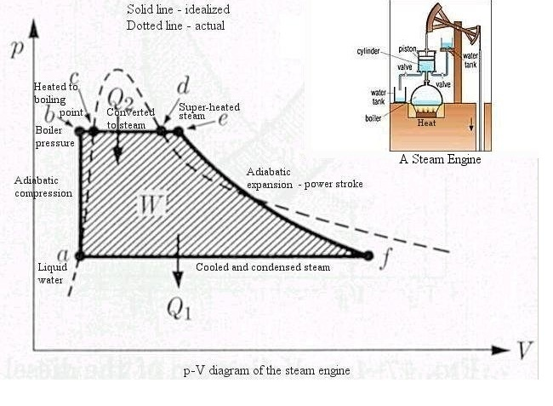
Steam Engine
Thermodynamics began with finding the ratio of Work done by engine to lift weight to coal consumed, related to Efficiency

Slide 3
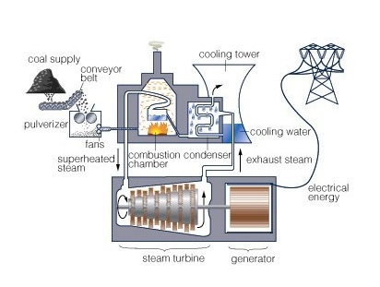
Objective is Power From Fuel
Steam Engines have gone away but we still have Coal Fired Power Plants:

Slide 4
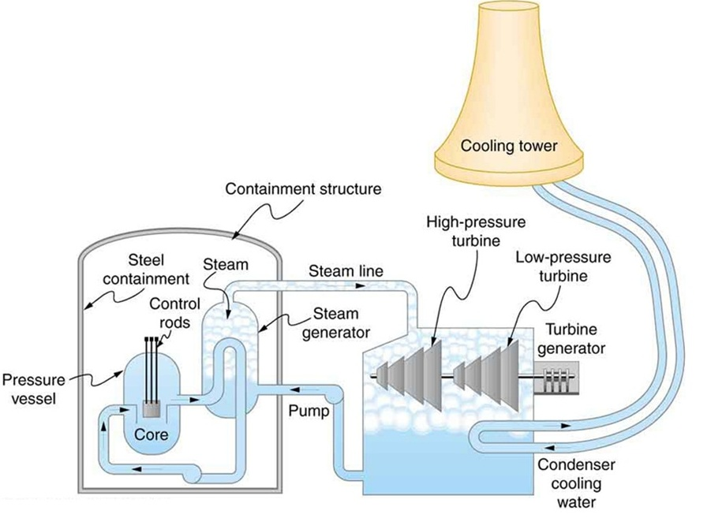
Steam is the Working Fluid
And when the fuel is Nuclear:

Slide 5
Working Fluid and Cycle
The Working Fluid as was Steam in Power Plant undergoes a sequence of heat and work transfer processes remaining unchanged in the end. This is what is called a Cycle. All Laws of Thermodynamics have special relevance to cycles. The devices like boiler, turbine and pump are analysed as separate or combined units and called Systems, with everything else around each of them known as Surroundings.

Slide 6
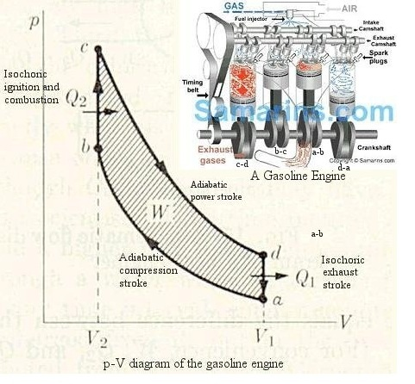
The Lightweight Vehicle
Petrol Engine

Slide 7
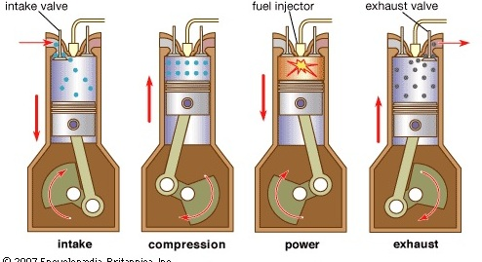
Internal Combustion Cycle
With Air As Working Fluid

Slide 8
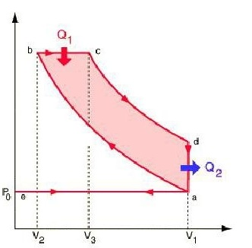
Diesel For Locos, Trucks and Ships
a-b : Compression; b-c: Fuel Injection and Burning; c-d: Power; d-a: Exhaust.

Slide 9
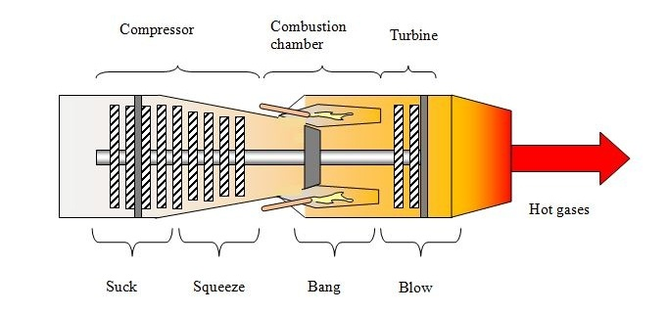
Jet Propulsion
Thrust and Lift ( working fluid: Air)

Slide 10
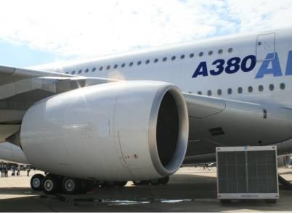
Mounted under Each Wing

Slide 11
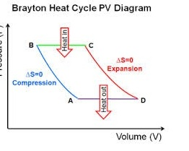
Using Brayton Cycle
A-B Compression
B-C Burner
C-D Turbine and Exhaust
D-E Cooling

Slide 12
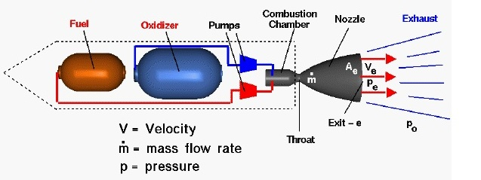
Space Propulsion
Chemical Rockets

Slide 13
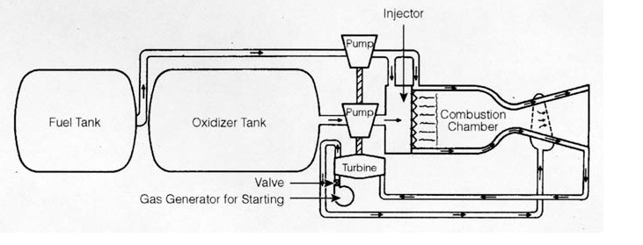
Rocket
Turbine work for Pump and Exhaust for Thrust
Working Fluid- Solid or Liquid Propellant and Oxidizer ( No Air)

Slide 14
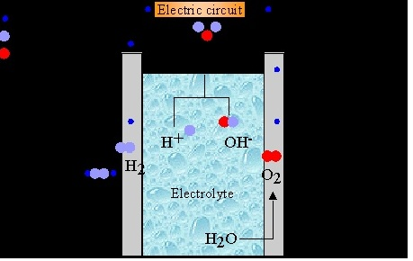
Fuel Cell
Electrolysis in Reverse with Ion Exchange Chamber: Hydrogen and Oxygen flow in and come out as Steam and release Heat and deliver Electricity. Energy Input is the Heat of Combustion of Hydrogen Fuel.

Slide 15
Refrigeration
Keeping
Objects Cool in Hot Ambience &
Objects Warm In Cold Ambience
By Spending Work to Move Heat against temperature rise.
Objective: COP: Desired Heat Effect per unit Work

Slide 16
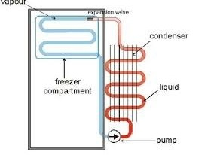
Vapour Compression Cycle
Volatile Liquid Diethyle Ether would cool as it Vaporized fast. To replenish the Liquid, the vapors had to be compressed and condensed releasing heat. Thus we have a cycle with working fluids, viz. Ammonia, Freon etc with special qualities.
The Refrigerant Cools the Inside and enters the pump which raises its pressure and temperature. The Blue regions are colder and the Brown areas hotter than the surroundings. When the Pump is off, the surroundings will make all regions come to the room temperature. You pay to keep the pump working.

Slide 17
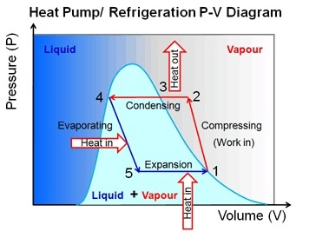
Pressure- Volume Diagram
The Vapour Compression Cycle:
The Heat In is the heat Leaking past the Insulation from outside.

Slide 18
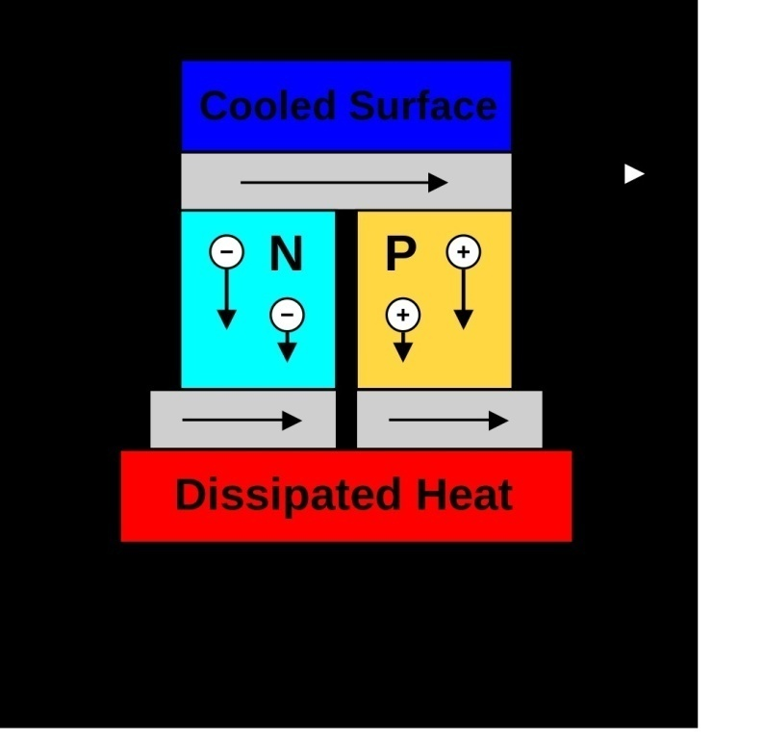
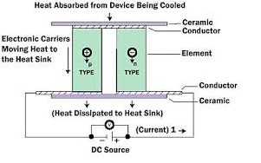
With Semiconductors
No Working Fluid needed, in Thermo- Electric Refrigeration: A Potential Difference Between two junctions of semi conductors makes one junction cold and one hot.

Slide 19
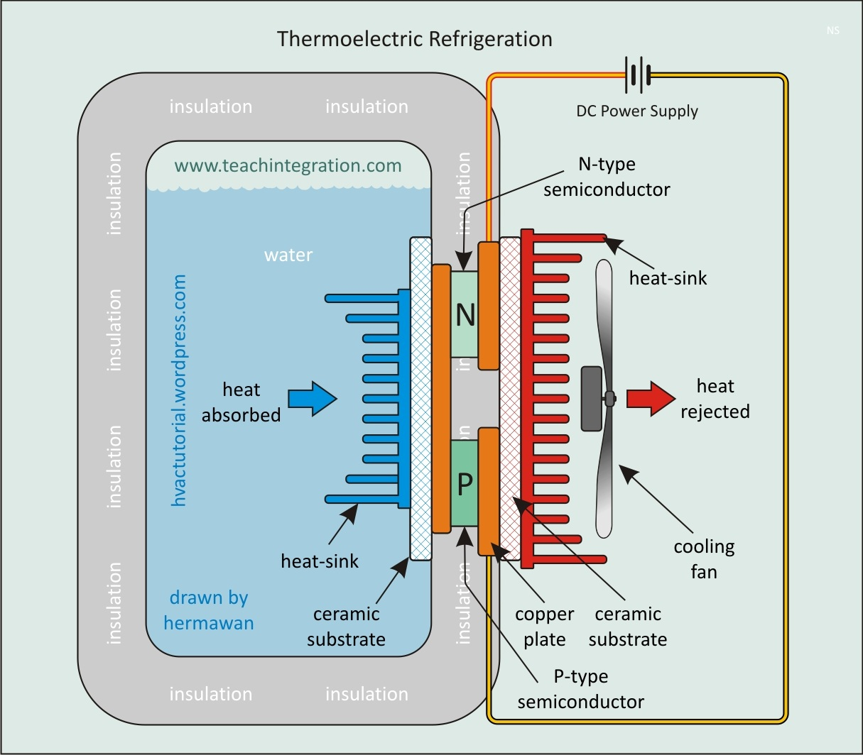
Laptops CPUs Need Cooling

Slide 20
Heat Engines and Heat Pumps
Thermoelectric Refrigeration in reverse can be used to generate electricity. Heat added to Hot Junction along with Heat rejected by Cold Junction will yield DC power. In summary all thermodynamic study involves either work or heat movement as the goal. In Heat Pumps the refrigeration system has to keep the hot reservoir heated to compensate the heat it loses to the cold surroundings as it would be if our houses had to be heated in winter. The Desired Effect for Refrigerators is Heat Removal from Cold End; for Heat Pumps it is Heat Addition to Hot End.
COP= Desired Effect
Work Added

